Slide 2
Introduction
Aleesha, LC CodeCamp alum
ROLE HAS CHANGED: instructor, not TF
Expectations:
Do Class Prep Work
Code WITH Class Prep videos.
General Schedule:
Studio Solution, Lecture, Studio Walkthrough, Studio

Slide 3
Questions?
t
If you have not downloaded FireFox, do it now.

Slide 4
LC 101
Unit 2 - Class 1
Git & HTML

Slide 5
What is VCS?
Version Control System
It’s software used to manage/organize computer files
Python, HTML, Java, XML, any type of file
Used on all types and sizes of projects
There are many different VCS software options
Git, SVN, TFS, CVS...

Slide 6
Why use a VCS?
Backup
Collaboration
Multiple people trying to edit the same files (word docs, spreadsheets)
VCS helps to manage everyone’s changes so they don’t get lost

Slide 7
Why use a VCS?
Versioning
Orderly way of keeping and accessing different versions of your work
Understanding What Happened
Comparing different versions of a file(s) can give insight, especially if you look at all the files changed “at the same time”

Slide 8
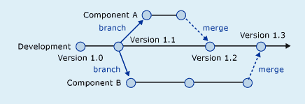

Slide 9
How do you use a VCS?
Install the VCS software on your computer
Setup a repository on your computer (two options)
1) create/initialize a repository in a folder OR
2) download/clone an existing remote repository
Commit files/changes to that repository
If using a remote repository you can push changes

Slide 10
What is committing?
Making the VCS system aware of changes
Could only be one file, but usually it will be more
This is how the changes are tracked, versioned, and shared
Adding versus Committing
Commit message
Short message about why and what you did
You will need this because you will eventually forget why you did EVERYTHING

Slide 11
Local Repo vs Remote Repo
Local
Is a repository on your computer only
You are working alone. Don’t need to share or backup
You won’t use this much if ever
Remote
Is a repository on a remote server that many people can use
Sort of confusing because you still have local files in a folder that references the remote repo

Slide 12
Using Git as your VCS
Install git on your computer
Learn the commands
remember the git cheat sheet Here.
Google: “git cheat sheet pdf”
git clone
git status
git add
git commit -m
git push
git log

Slide 13
Studio Walkthrough

Slide 14
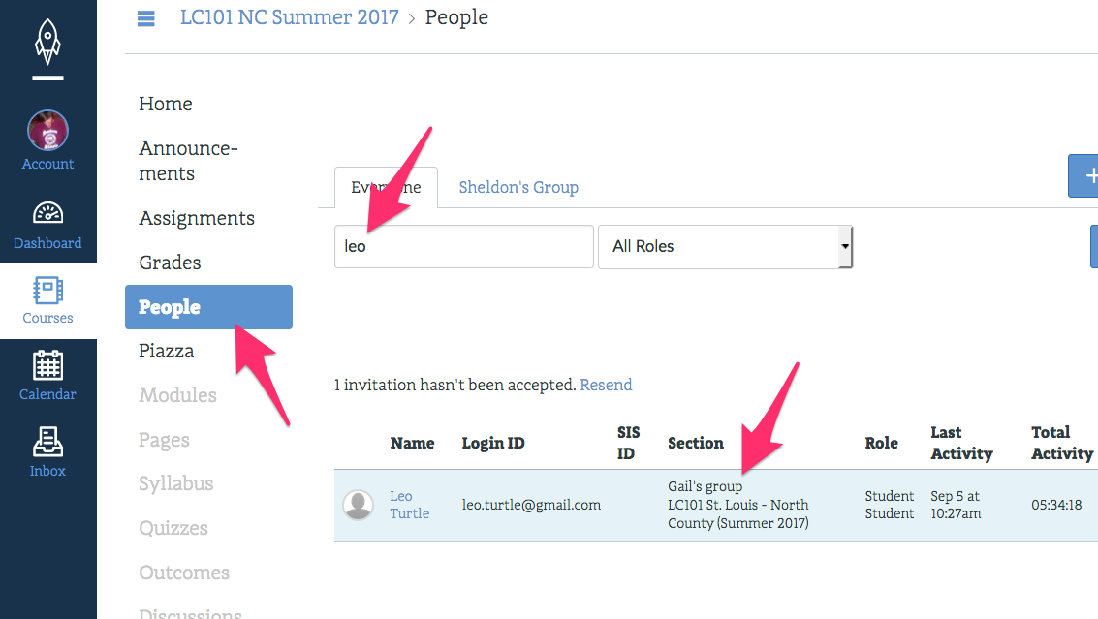
Lookup your new TF: LC101 -> People -> Search by name

